Slide 1
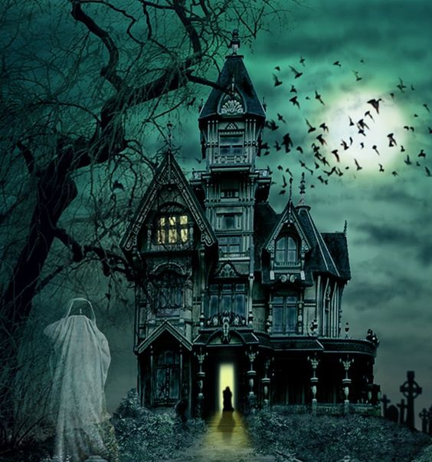

House of Shadows

Slide 2
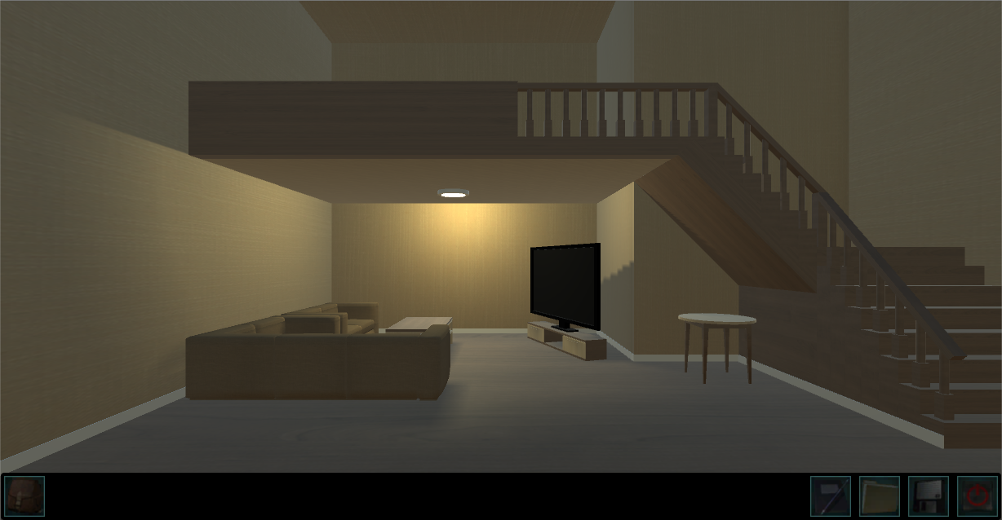
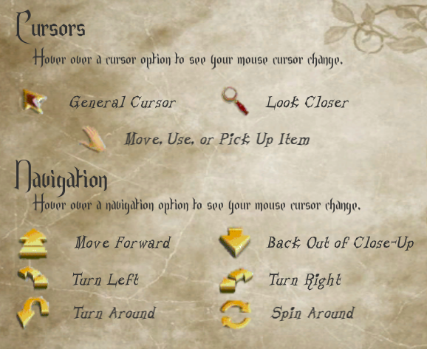
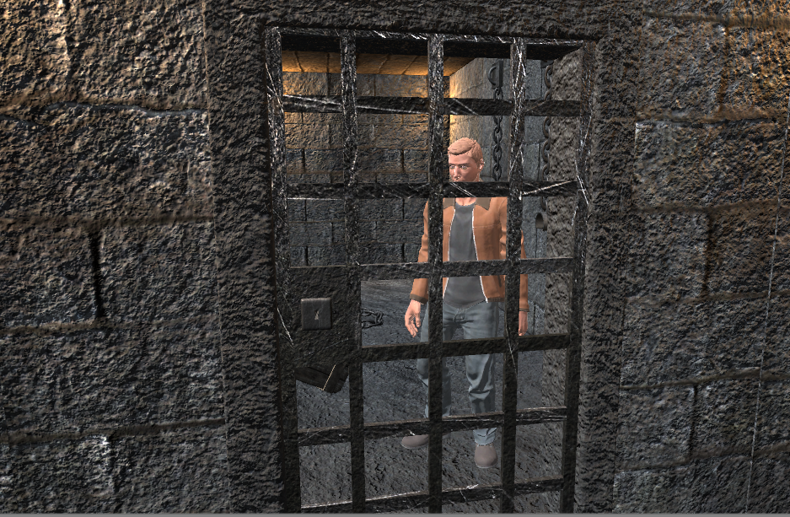
What is House of Shadows?
Single-Player Horror Adventure
Point-and-Click Gameplay
Solve the mystery of your lost twin by solving various puzzles and overcoming challenges.

Slide 3
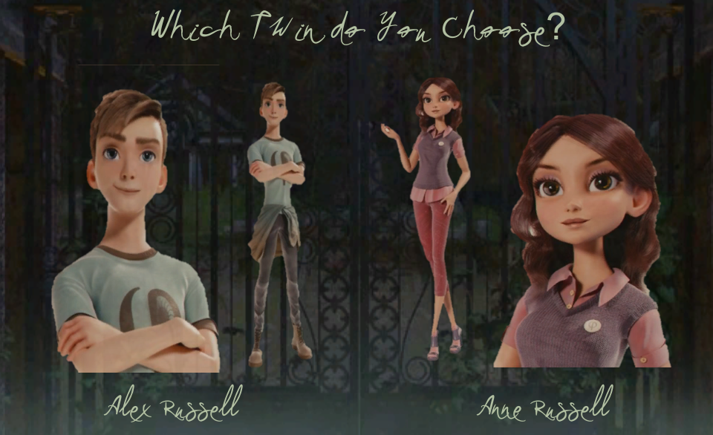
Begin by Choosing Your Character
With a dynamic narration feature,
the game will remember your
choice and will adapt gameplay
and dialogue to reflect which
character you have chosen, vs.
which character will then become
the missing sibling.

Slide 4
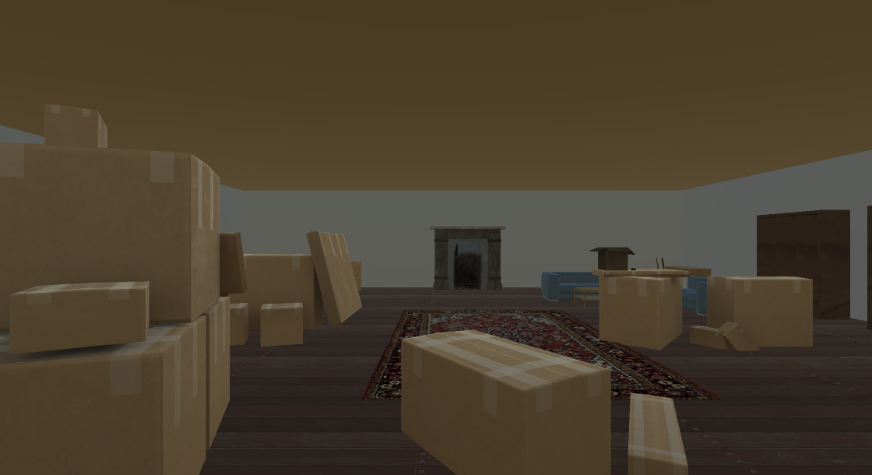
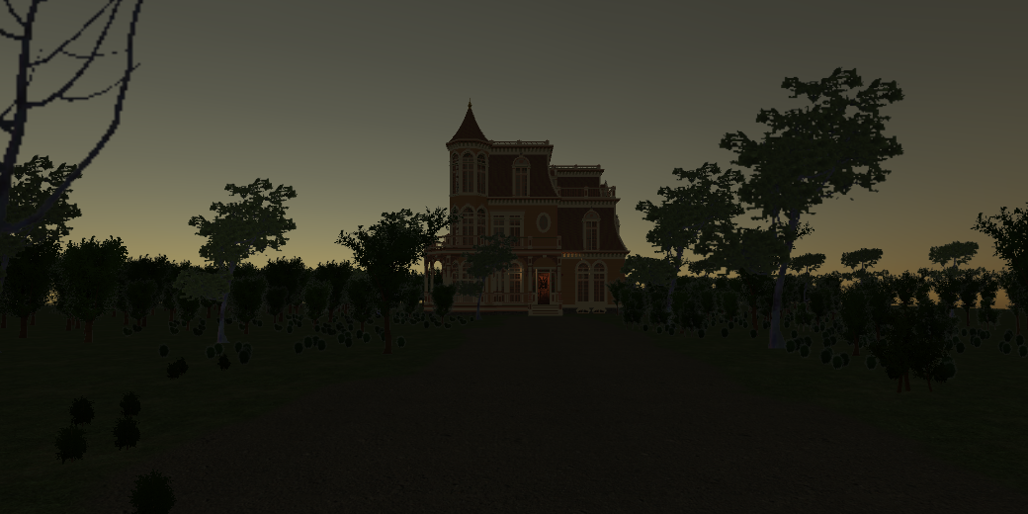
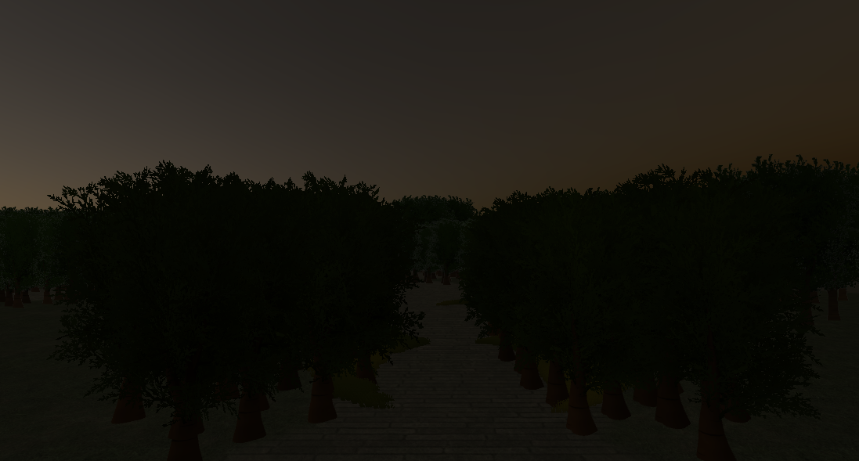
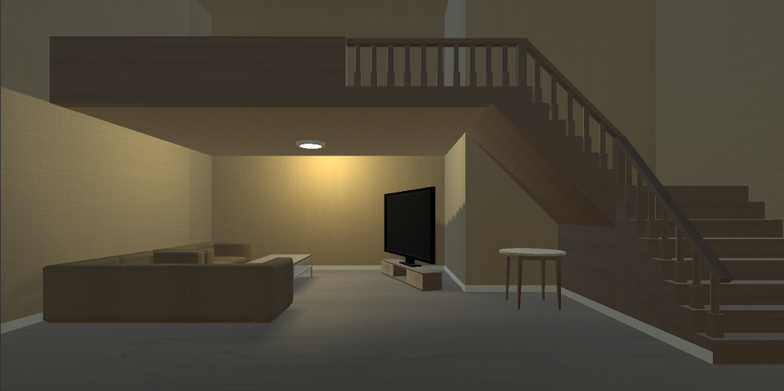
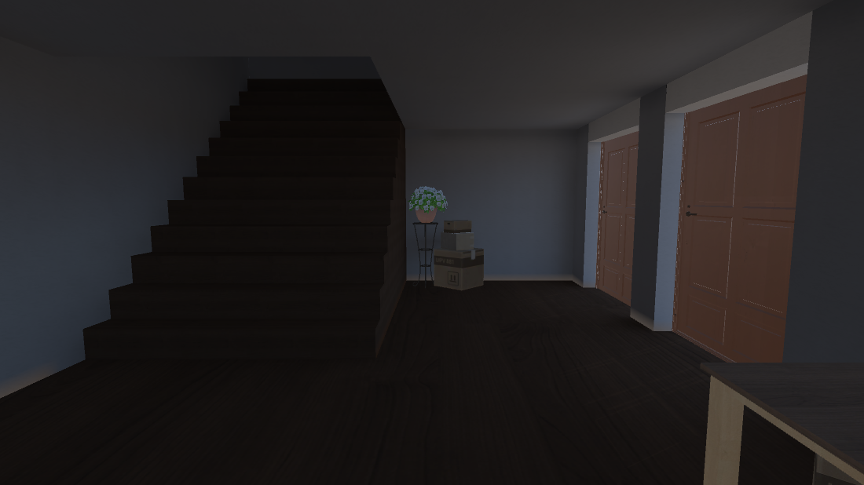
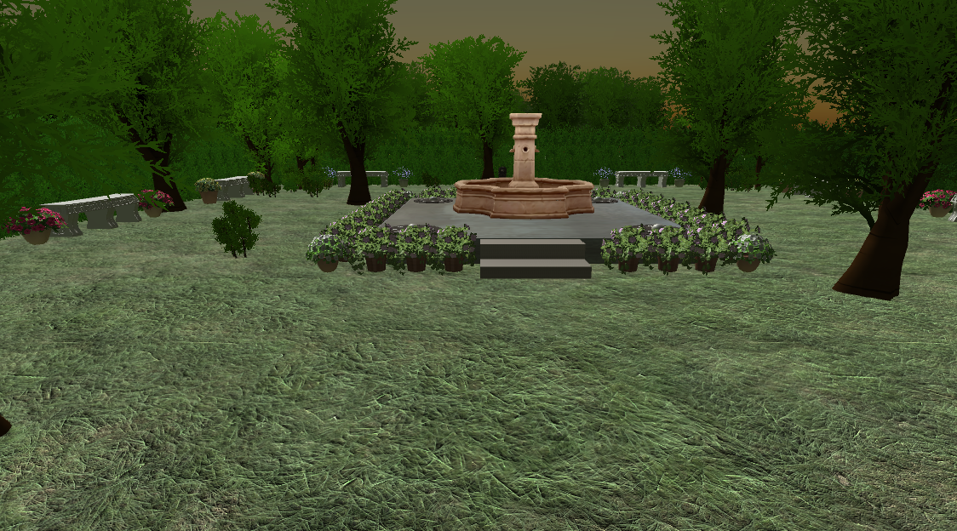
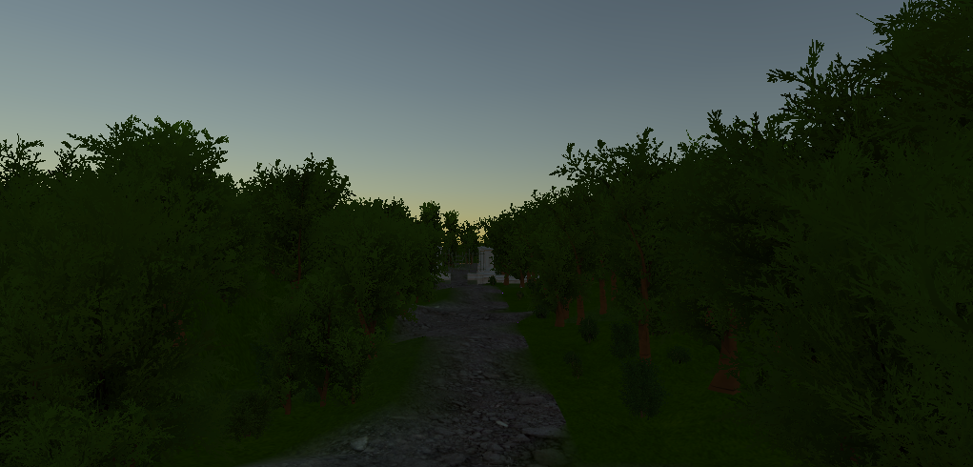
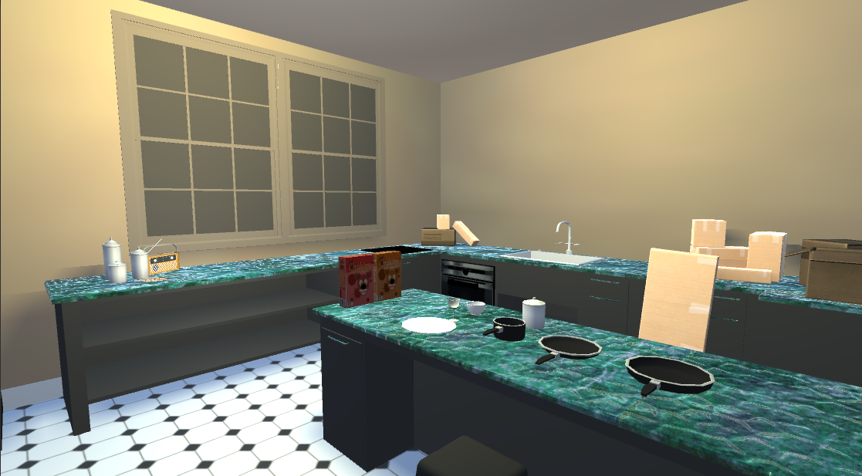
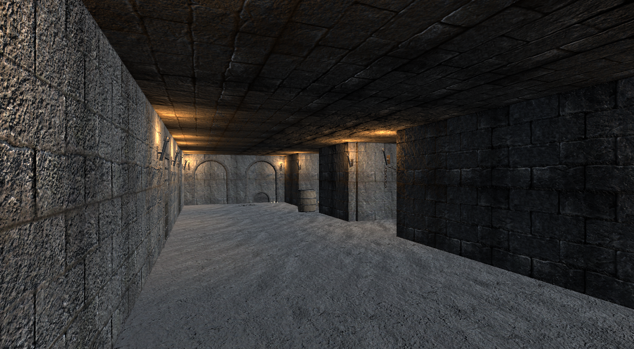
The House
The game consists of several levels that the player may explore as they gather new items to open new areas of the house and its surrounding grounds. The game contains 12 levels in total.

Slide 5
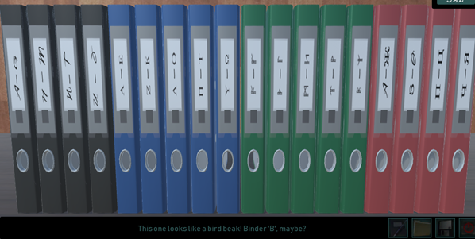
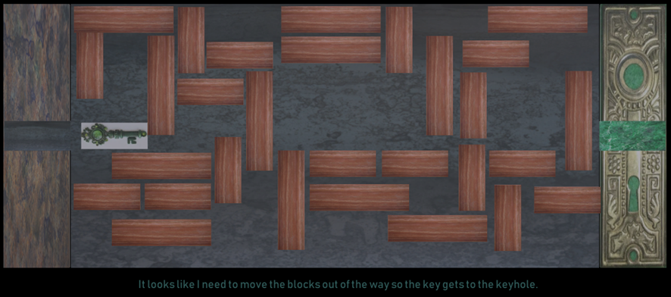
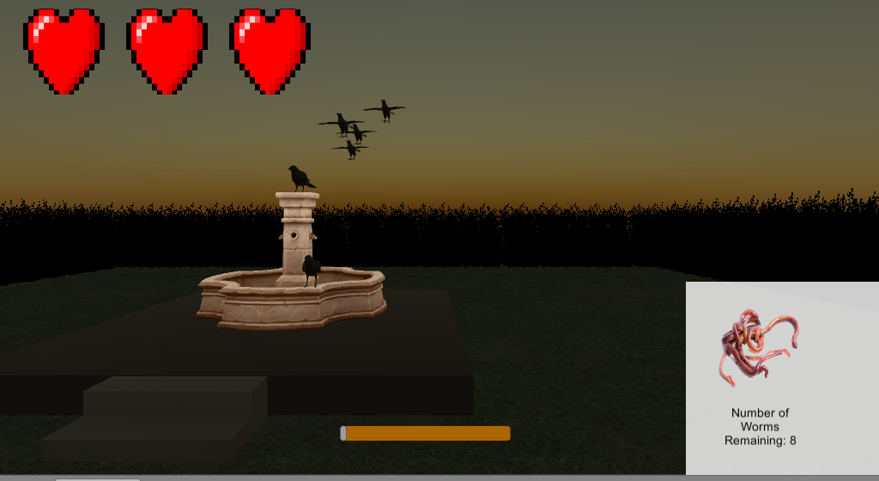
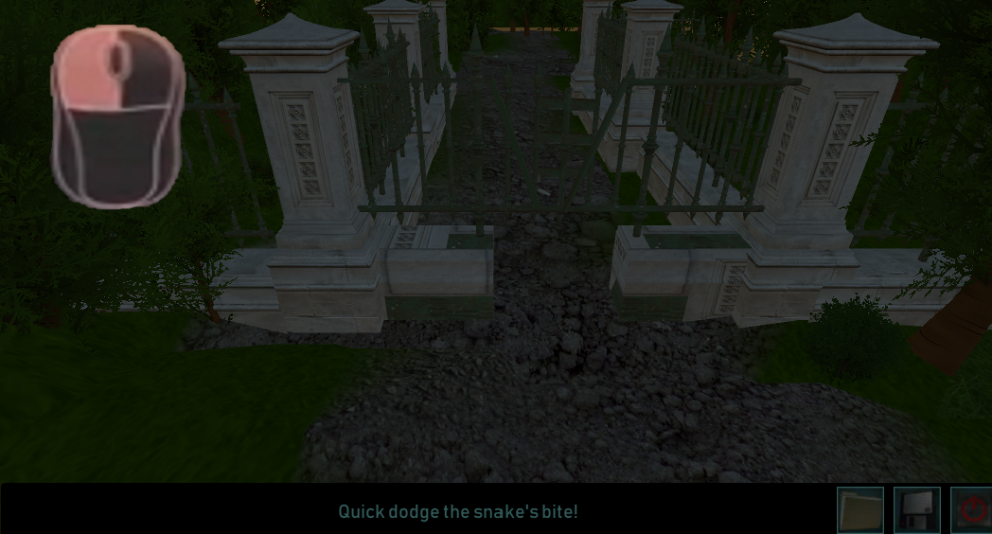
Minigames
The player must acquire items hidden throughout the game, and use them to complete various tasks to progress through the levels. The game will end if the player fails in any of these tasks, and they will have to restart the level.

Slide 6
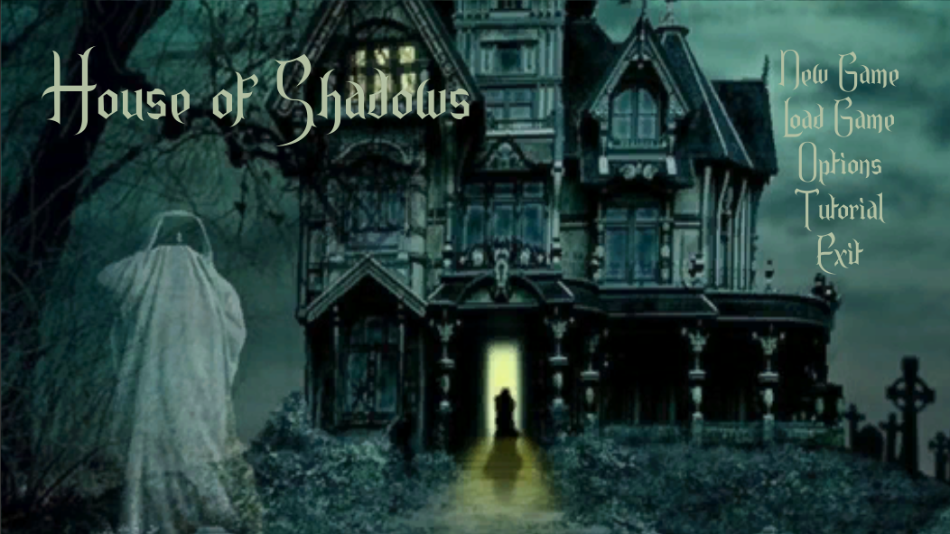
Menu and UI
House of Shadows features a menu driven UI system that allows the player to modify their in game options, view the various interactable mouse options in the tutorial, and start and load their save game files.

Slide 7
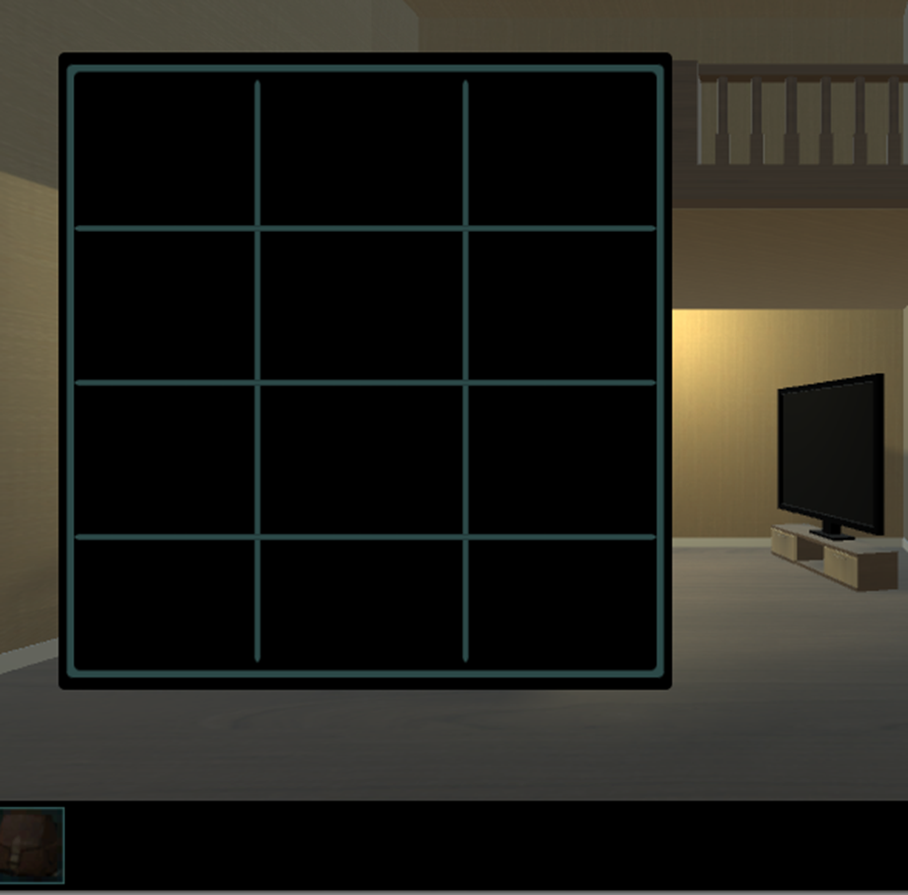
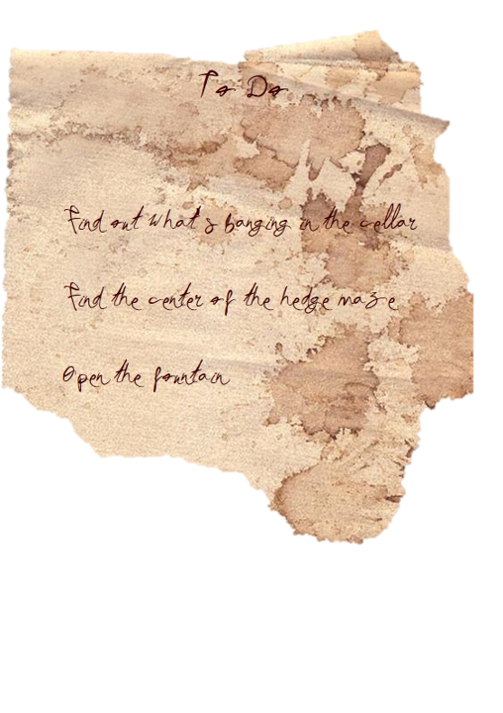

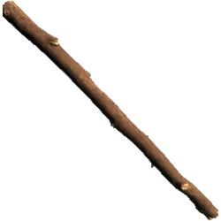
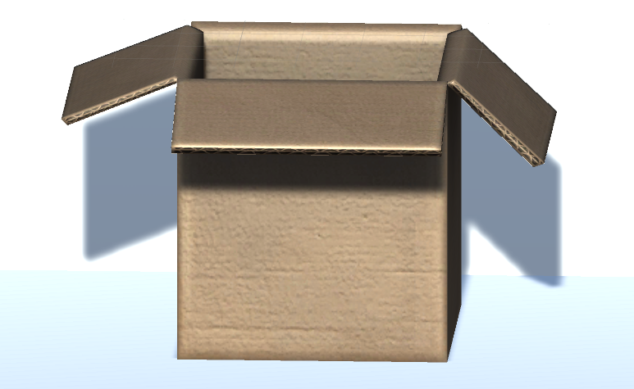
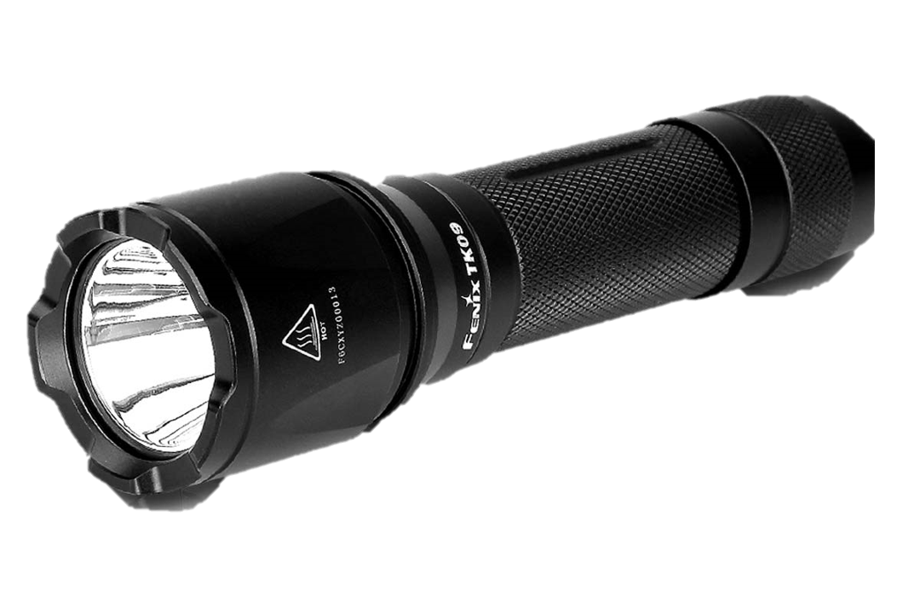
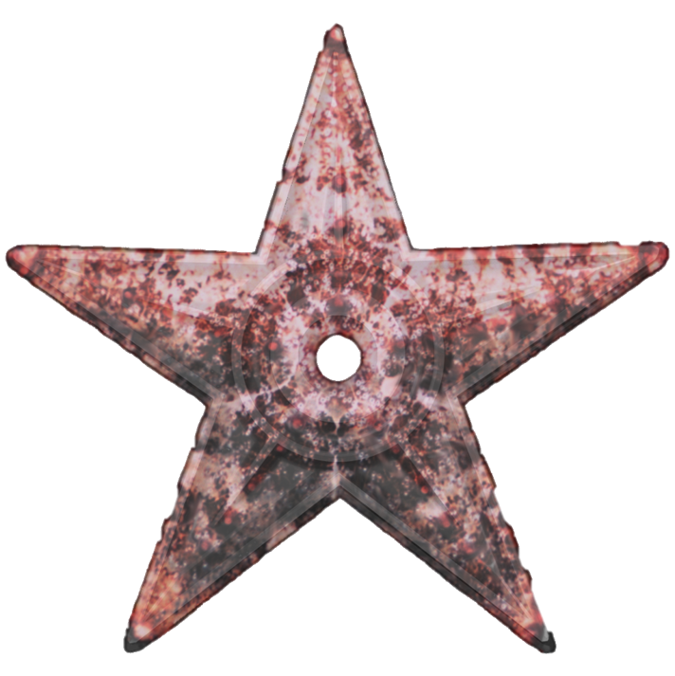

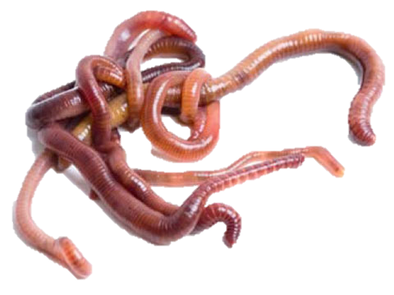
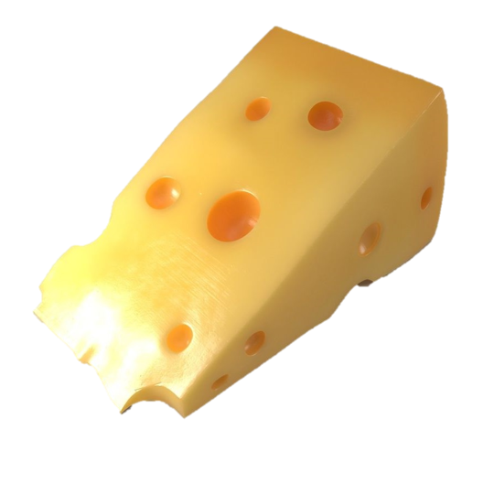
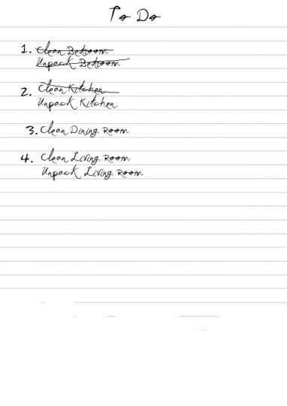
Inventory
The player must acquire ten items to progress through all of the levels available in the game. Once acquired the items will be viewable from the inventory screen, and often the player will be prompted to use the item, once they enter an area where it is necessary.

Slide 8
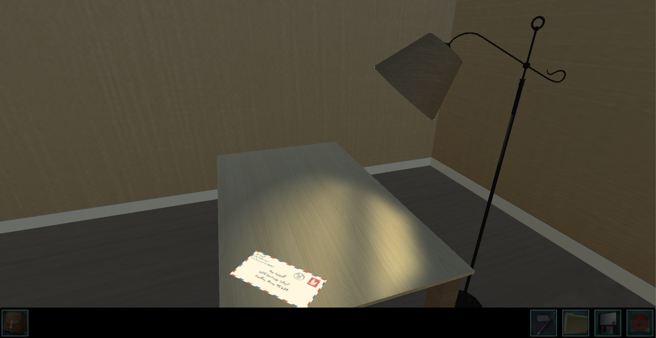
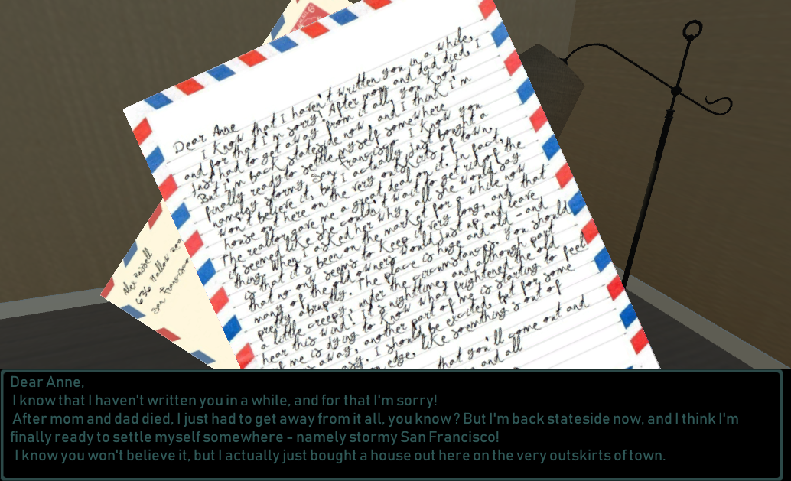
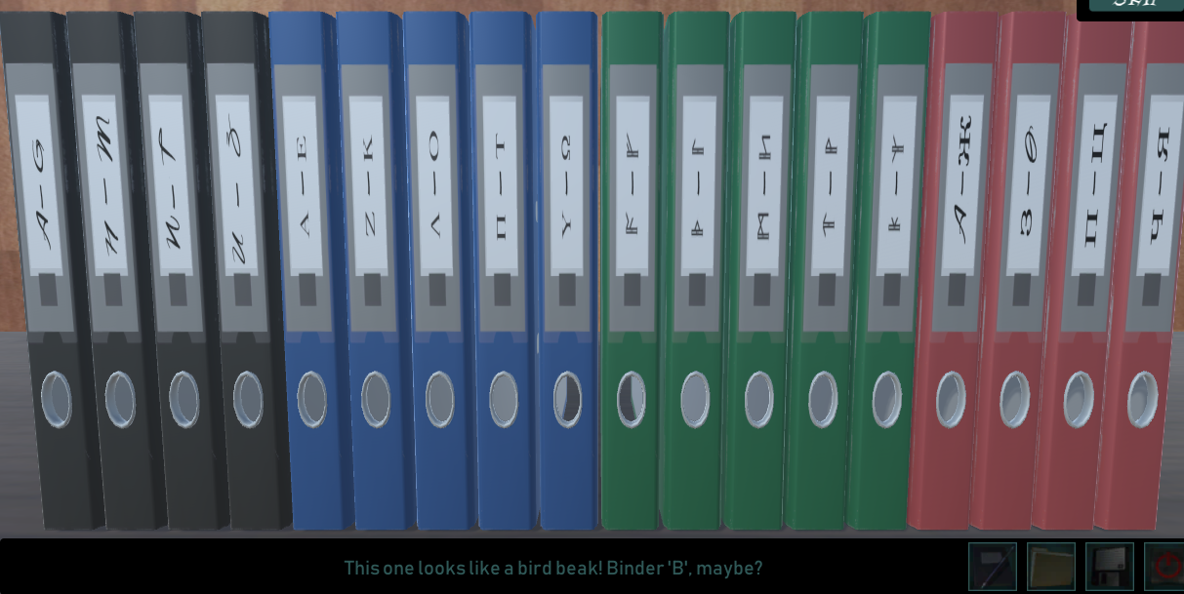
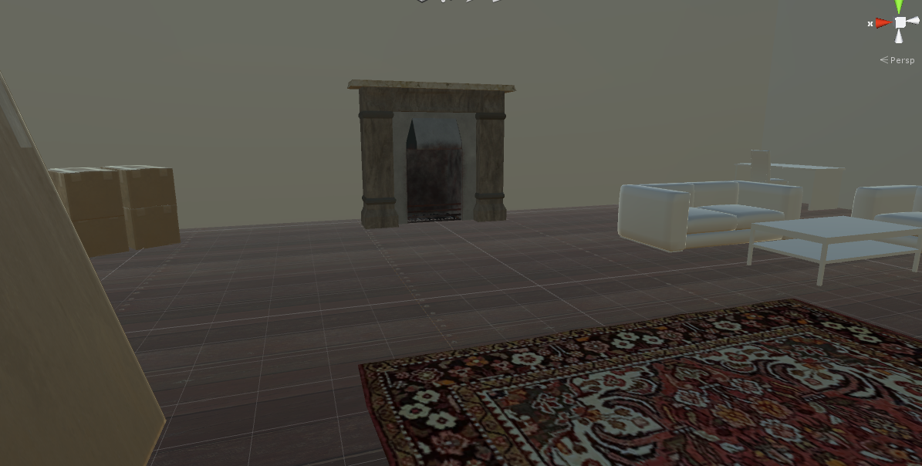

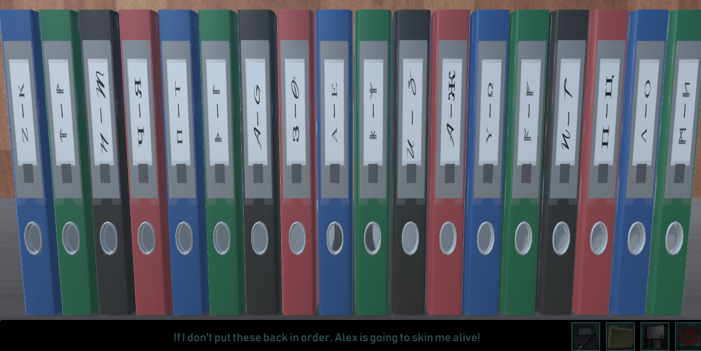

Slide 9
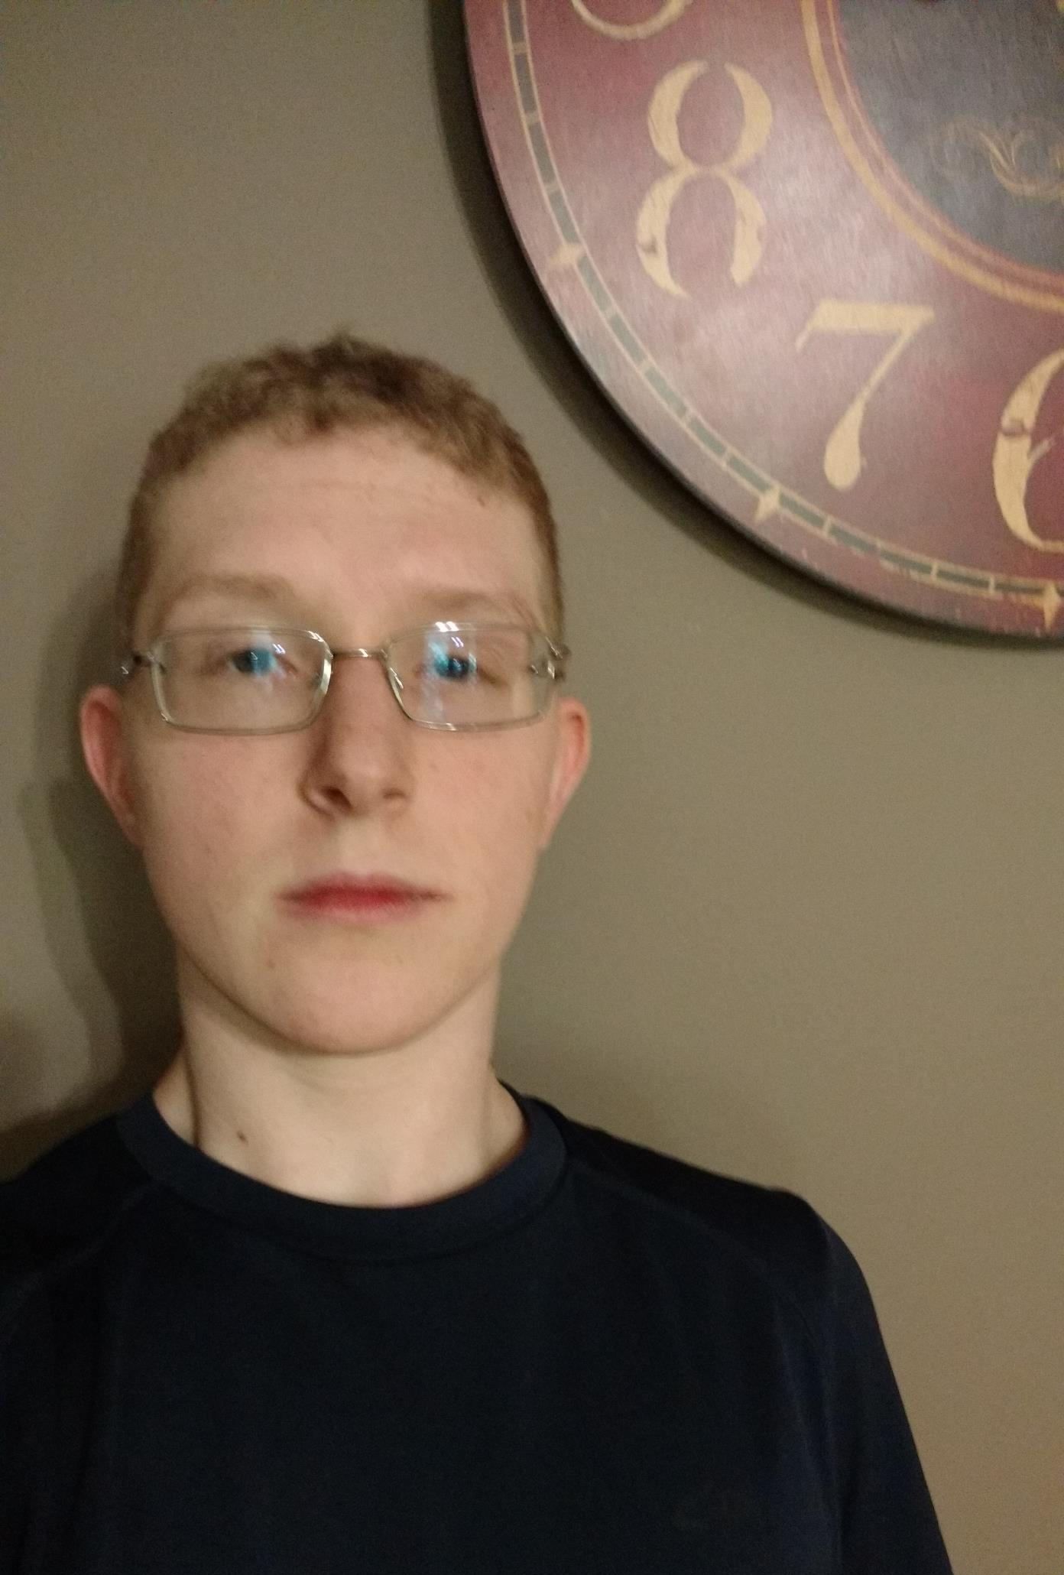
Justin Masters
Worked on scene testing and bugfixing
Created the raven minigame and snake minigame.
Created the Hedge Maze, Living Room, Gate, Hedge Maze Center, and House Exterior levels.
Worked on general scripting.
Created Game Manager and Inventory systems.
Created game save system.

Slide 10
